Slide 1
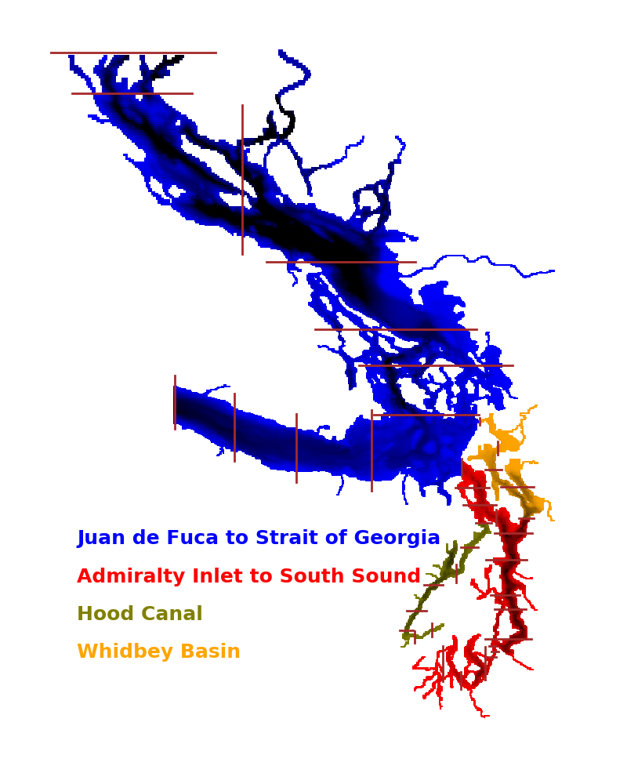
matplotlib Making your figures beautiful
This PPT and associated code has useful tips about how to get your figures to be more effective in presentations and publications. It is part graphical advice, and part about how to get matplotlib to do what you want.
Associated code at:
https://github.com/parkermac/pmec.git

Slide 2
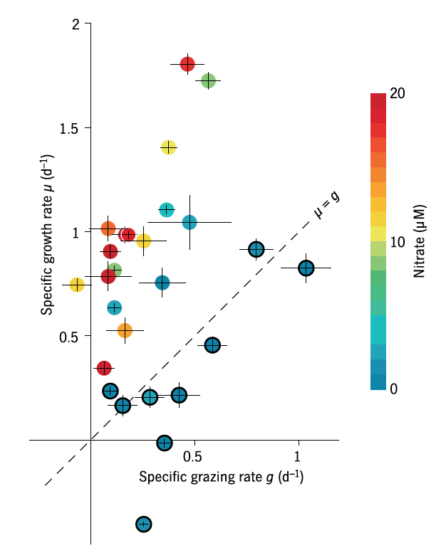
Keep it simple

Slide 3
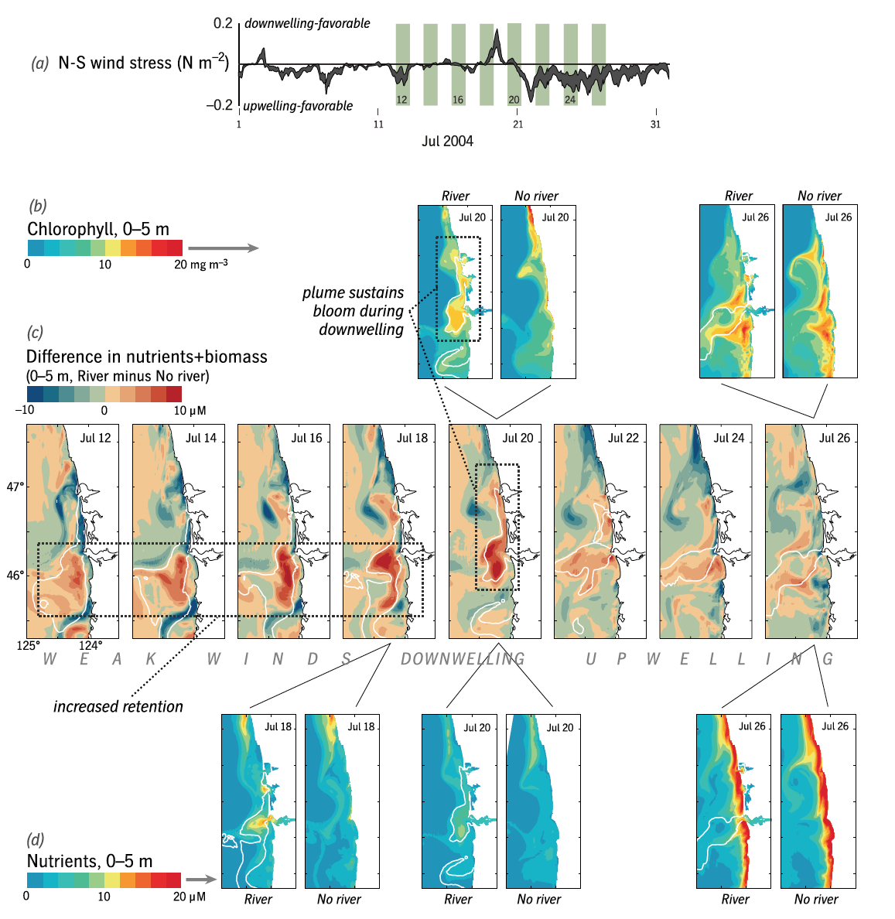
Maximal control, by Neil Banas

Slide 4
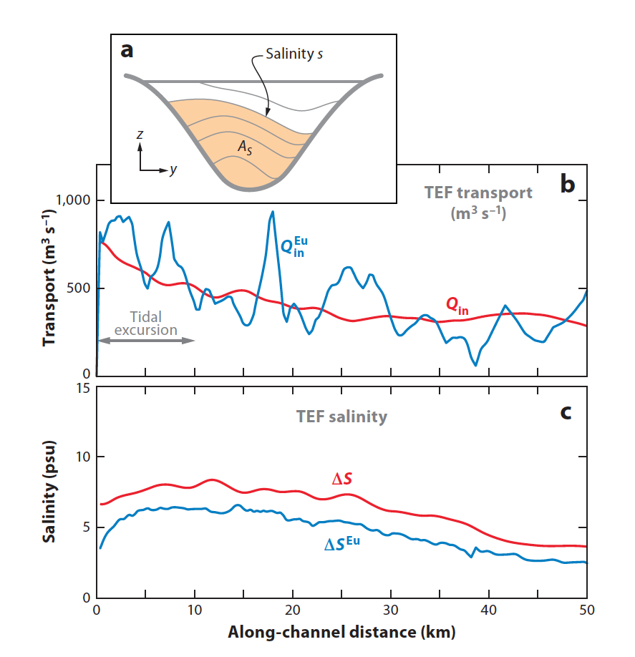
Professional touches, from Annual Reviews

Slide 5
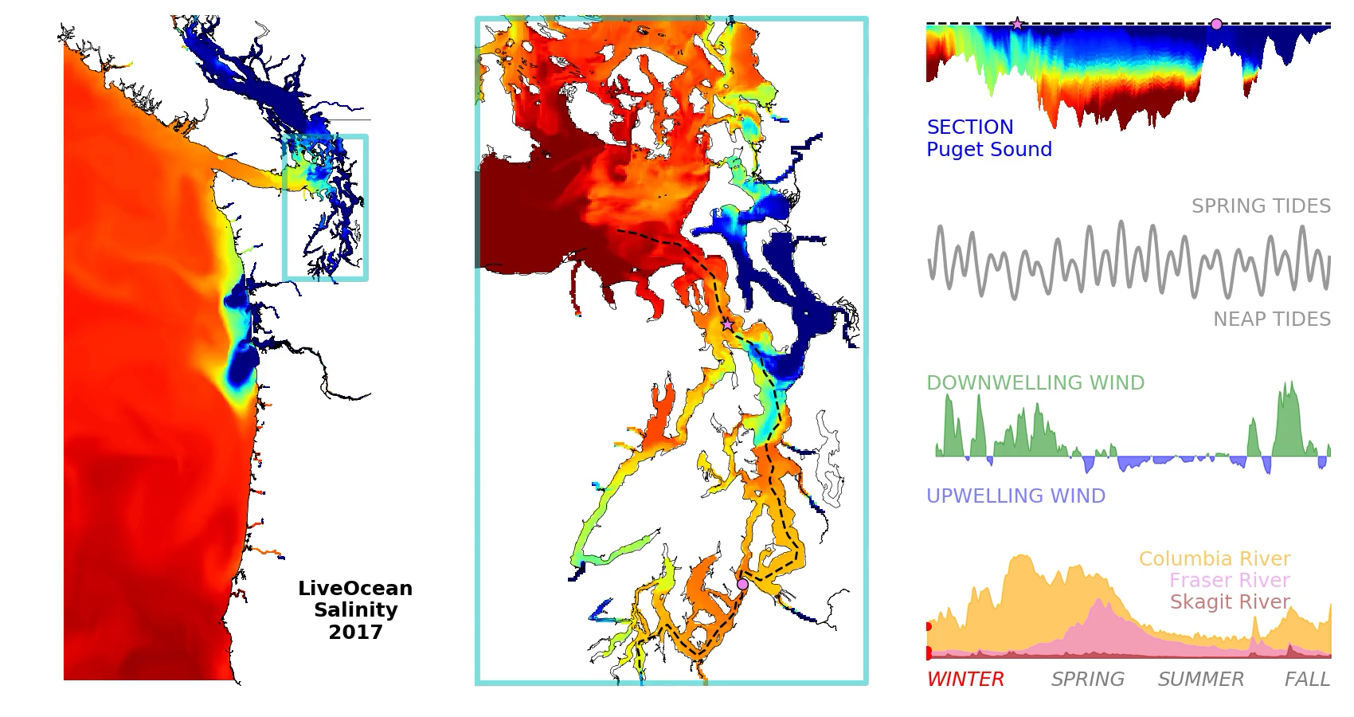
Movies can be made from collections of .png's using ffmpeg
Instructions for getting ffmpeg (mac): http://faculty.washington.edu/pmacc/LO/movies.html

Slide 6
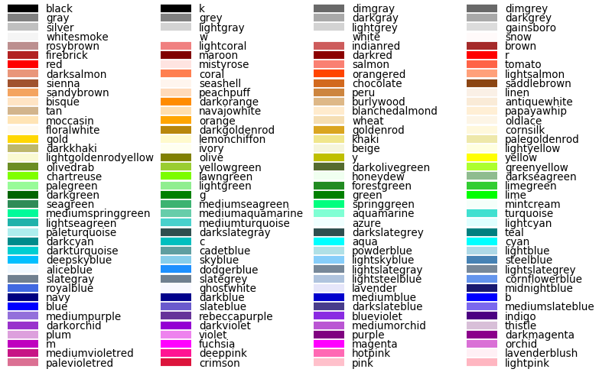
Color names you can use

Slide 7
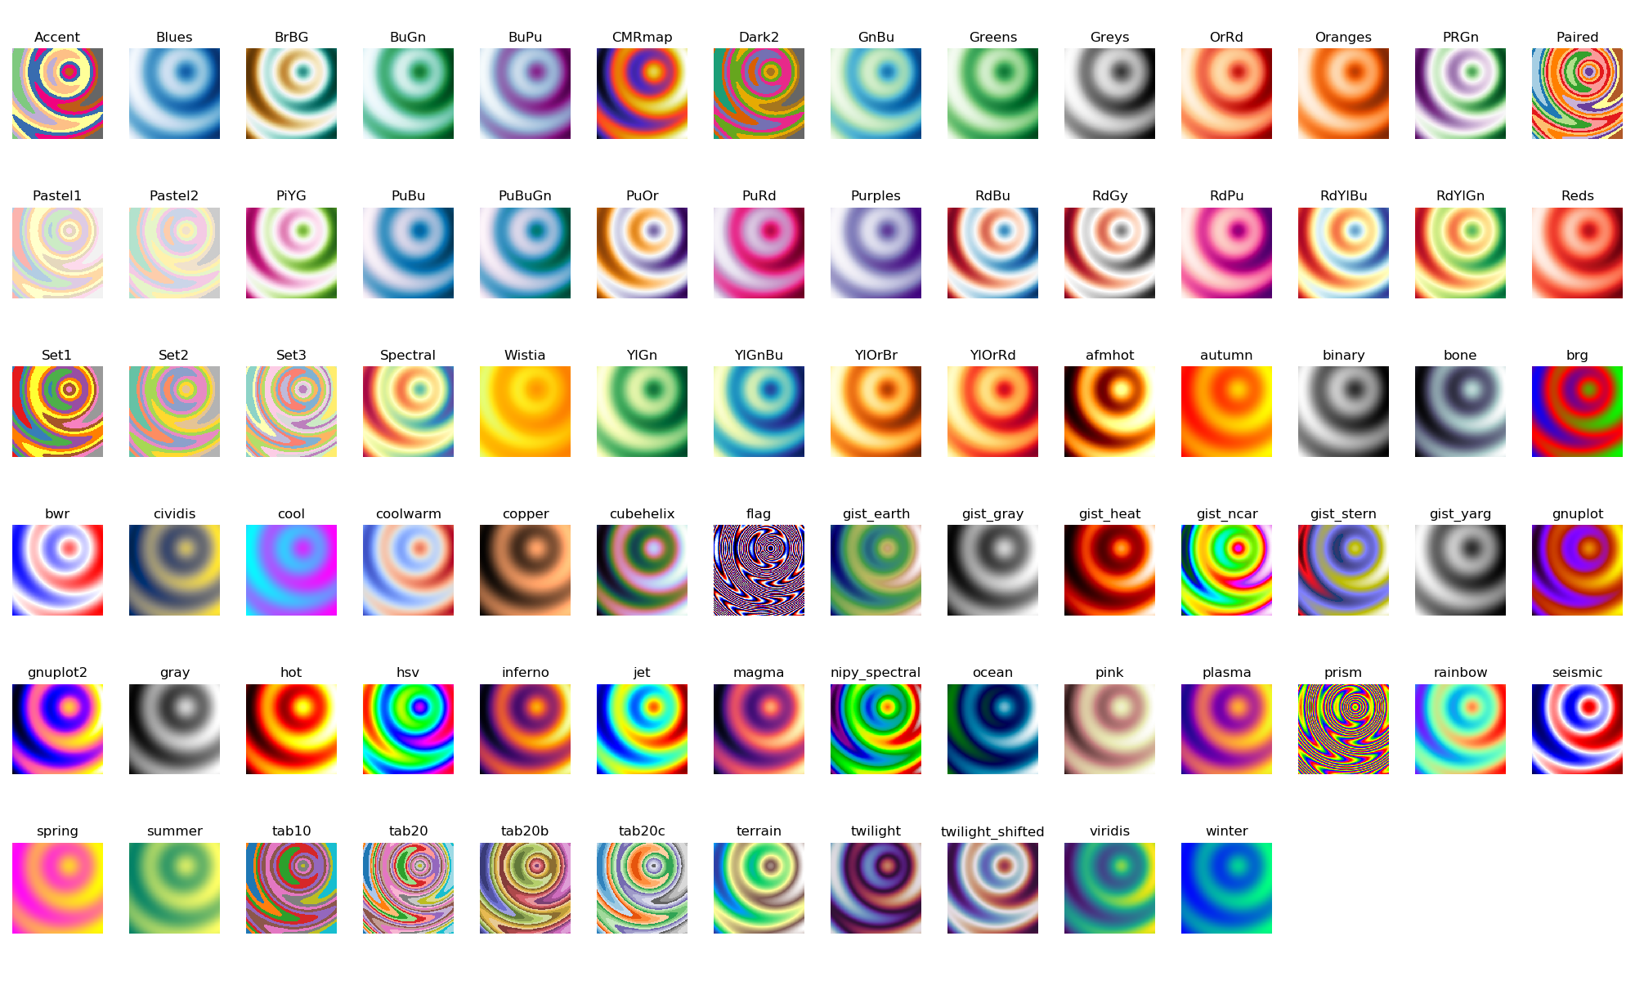
Colormaps (also available as [cmap]_r)
example_show_colormaps.py

Slide 8
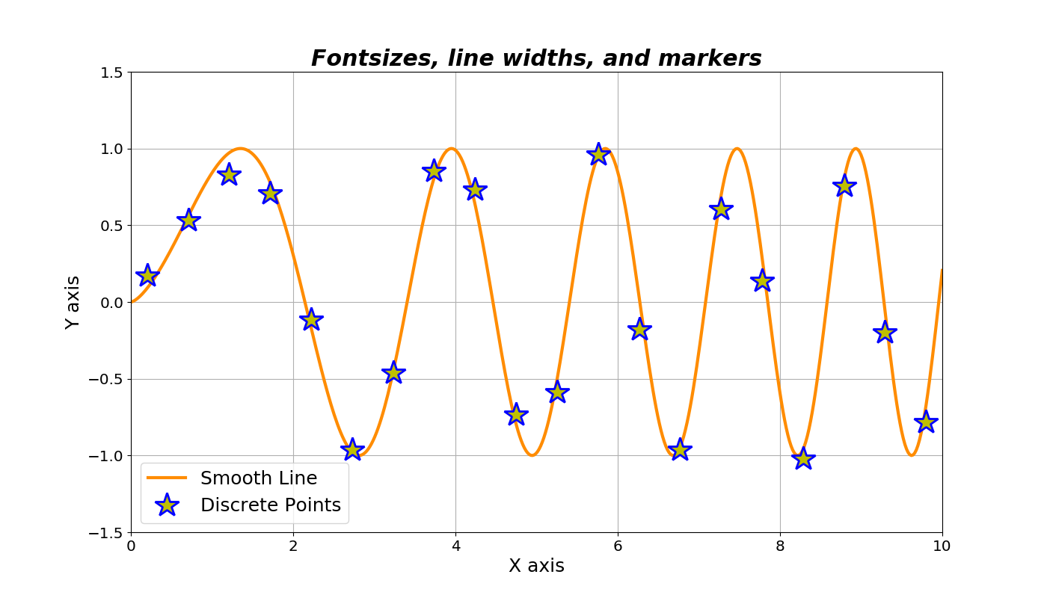
fontsize_and_linewidth.py

Slide 9
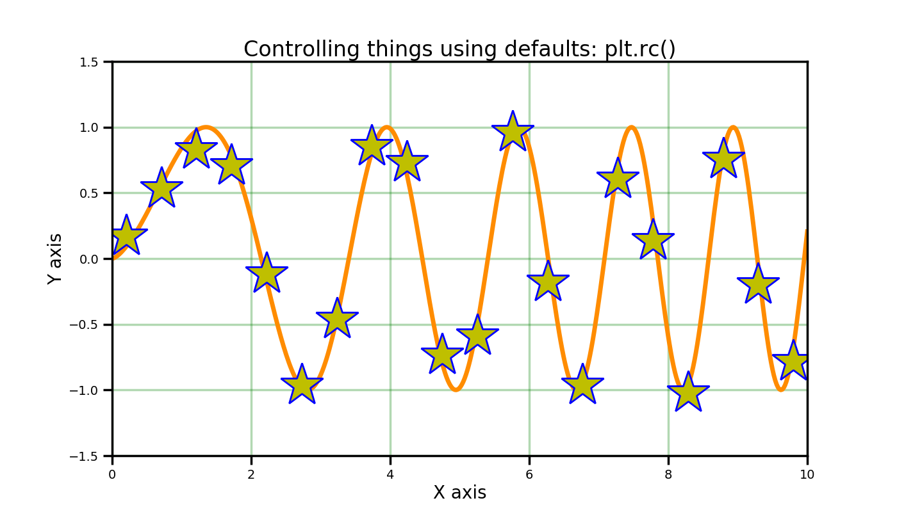
fontsize_and_linewidth.py ...more

Slide 10
more thoughts about using defaults
One of the quickest ways to make all your text big enough to read is to use these few lines at the start and end of the plotting section of your code:
fs = 18 # set default fontsize
plt.rc('font', size=fs)
# -- plotting code goes here --
plt.rcdefaults() # restore defaults

Slide 11
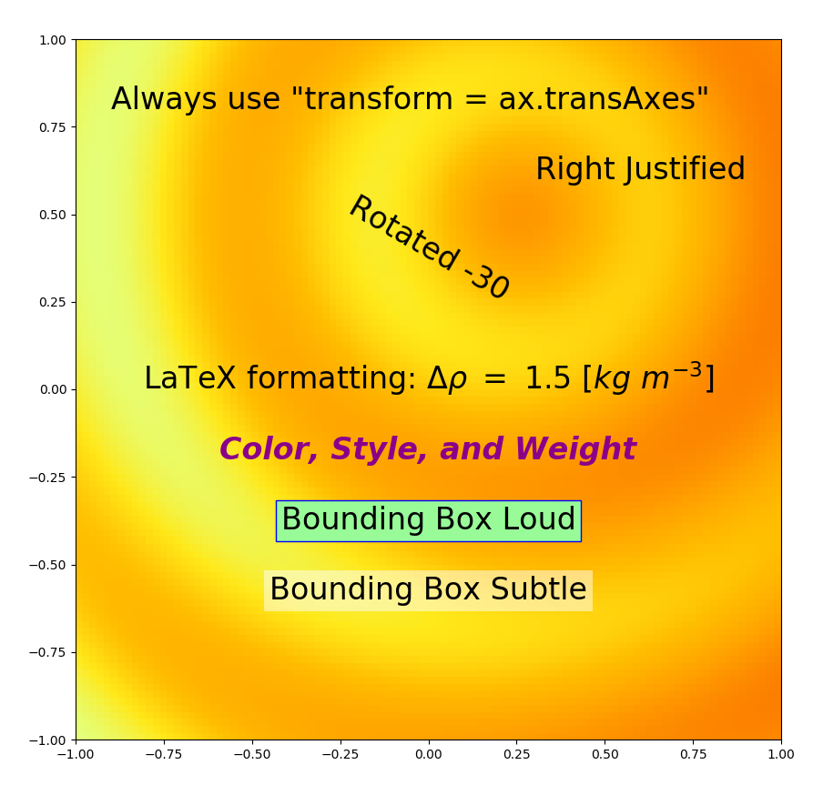
text_control.py

Slide 12
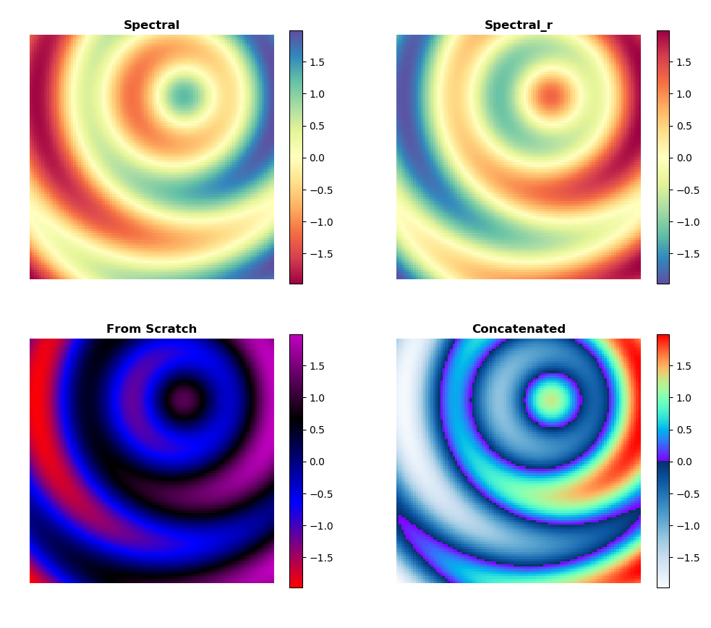
colormaps.py and ax.set_axis_off()

Slide 13
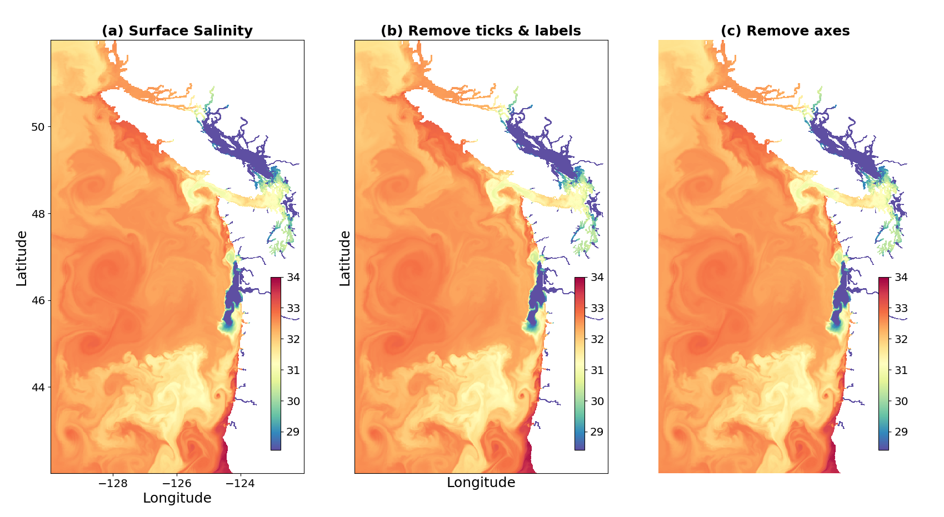
salt_map.py: aspect ratio and inset colorbar

